Slide 1
5.9 smallsh: a command processor

Slide 2
basic logic of command processor
while(EOF not typed)
{
get command line from user ← fgets()
assemble command args and execute ← excute_cmdline()
}

Slide 3
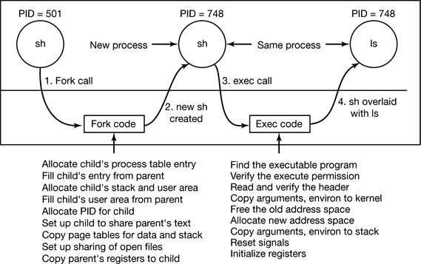

Slide 4
The strtok(3) system call
#include <string.h> char *strtok(char *restrict s1, const char *restrict s2);
Return: A pointer to the last token found in string. A null pointer is returned if there are no tokens left to retrieve.
int main(){
char str[] = "unix system prog";
char* delimiters = " \t";
char* token;
token = strtok(str, delimiters);
while(token!=NULL){
printf("%s\n", token);
token = strtok(NULL, delimiters);
}
return 0;
}
str
u | n | i | x |  | s | y | s | t | e | m |  | p | r | o | g | \0
str
u | n | i | x | \0 | s | y | s | t | e | m | \0 | p | r | o | g | \0

Slide 5
The strspn(3) system call
#include <string.h> size_t strspn(const char *s1, const char *s2);
Return: - The length of the initial portion of s1 containing only characters that appear in s2. - if all of the characters in s1 are in s2, the function returns the length of the entire str1 string - if the first character in s1 is not in s2, the function returns 0.
int a = strspn("aabbcc", "a"); //a = 2
int b = strspn("aabbcc", "b"); //b = 0
int c = strspn("aabbcc", "d"); //c = 0
int d = strspn("aabbcc", "abc"); //d = 6

Slide 6
smallsh – global variable & functions
#include <errno.h>
#include <stdio.h>
#include <stdlib.h>
#include <string.h>
#include <unistd.h>
#include <sys/wait.h>
#include <fcntl.h>
#define MAX_CMD_ARG 10
#define MAX_CMD_GRP 10
const char *prompt = "Command> ";
char* cmdgrps[MAX_CMD_GRP];
char* cmdvector[MAX_CMD_ARG];
char cmdline[BUFSIZ];
void fatal(char *str);
void execute_cmd(char *cmd);
void execute_cmdgrp(char* cmdgrp);
int makelist(char *s, const char *delimiters,
char** list, int MAX_LIST);
Command> ls –l ; ps
GRP1
GRP2
cmdline
l | s |  | - | l |  | ; |  | p | s
BUFSIZ
cmdvector
cmdgrps
MAX_CMD_ARG
MAX_CMD_GRP
• | • | • | • | • | •
• | • | • | • | • | •

Slide 7
smallsh – main()
int main(int argc, char**argv)
{
int i=0;
while (1) {
fputs(prompt, stdout);
fgets(cmdline, BUFSIZ, stdin);
cmdline[ strlen(cmdline) -1] ='\0';
execute_cmdline(cmdline);
printf("\n");
}
return 0;
}
void fatal(char *str)
{
perror(str);
exit(1);
}

Slide 8
smallsh – execute_cmdline()
void execute_cmdline(char* cmdline)
{
int count = 0;
int i=0;
count = makelist(cmdline, ";", cmdgrps, MAX_CMD_GRP);
for(i=0; i<count; ++i)
{
switch(fork())
{
case -1: fatal("fork error");
case 0: execute_cmdgrp(cmdgrps[i]);
default:
wait(NULL);
fflush(stdout);
}
}
}
cmdline = “ls –l ; ps”
cmdline
l | s |  | - | l |  | \0 |  | p | s
NULL
cmdgrps
• | • | • | • | • | •

Slide 9
smallsh – execute_cmdgrp()
void execute_cmdgrp(char *cmdgrp)
{
int i=0;
int count = 0;
count = makeargv(cmdgrp, " \t", cmdvector, MAX_CMD_ARG);
execvp(cmdvector[0], cmdvector);
fatal("exec error");
}
cmdgrp = “ls –l ”
cmdgrp
l | s | \0 | - | l |  | \0
NULL
cmdvector
• | • | • | • | • | •

Slide 10
smallsh – makelist()
int makelist(char *s, const char *delimiters,
char** list, int MAX_LIST){
int i = 0;
int numtokens = 0;
char *snew = NULL;
if( (s==NULL) || (delimiters==NULL) ) return -1;
snew = s + strspn(s, delimiters); //delimiters를 skip
if( (list[numtokens]=strtok(snew, delimiters)) == NULL )
return numtokens;
numtokens = 1;
while(1){
if( (list[numtokens]=strtok(NULL, delimiters)) == NULL)
break;
if(numtokens == (MAX_LIST-1)) return -1;
numtokens++;
}
return numtokens;
}

